Slide 1
EC3290 – Software Requirements Engineering
Topic 1 – Introduction to Requirements Engineering
CLO 1
4 Hours

Slide 2
Introduction to Software Engineering
Definition: Software engineering is the application of engineering principles to the development, operation, and maintenance of software systems. It involves a systematic, disciplined, and quantifiable approach to software development, ensuring high quality and efficiency.
Key Components:
Processes: These are structured sequences of activities that guide software development, such as planning, analysis, design, implementation, testing, and maintenance. Processes ensure a systematic approach and are often tailored to project needs.
Tools: Software tools are used to support processes and methodologies. Examples include integrated development environments (IDEs), version control systems, and testing frameworks.
Methodologies: These are frameworks that dictate how processes are implemented. Examples include Agile, Waterfall, and DevOps. Methodologies help teams align on goals and strategies throughout the project lifecycle.

Slide 3
Software Development Lifecycle (SDLC) Overview
Planning
Analysis
Design
Implementation
Maintenance

Slide 4
Importance of Processes in Software Development
Ensures Consistency and Quality: Well-defined processes help maintain consistency across teams and projects. By following standard procedures, teams can deliver software that meets quality expectations and adheres to best practices.
Manages Complexity and Reduces Risks: Software development often involves handling complex systems and technologies. Processes help break down these complexities into manageable steps and identify potential risks early, allowing teams to mitigate them proactively.
Facilitates Communication Among Stakeholders: Processes provide a common framework and terminology for developers, project managers, clients, and other stakeholders. This fosters better collaboration, clearer expectations, and alignment on project goals.

Slide 5
Relationship Between Software Processes and Requirements
Foundation of Subsequent Phases: Requirements serve as the cornerstone of software development. They define what the software must do and set the scope of the project. All subsequent phases—design, implementation, testing, and maintenance—rely on accurate and comprehensive requirements.
Impact of Poor Requirements: Ambiguous, incomplete, or incorrect requirements can lead to misaligned development efforts, increased costs, and delays. In worst-case scenarios, poor requirements can result in the complete failure of a project.
Processes to Improve Requirement Quality:
Requirement Elicitation: Engaging stakeholders through interviews, surveys, and workshops to gather detailed requirements.
Requirement Validation: Ensuring requirements are clear, consistent, and feasible before moving to the design phase.
Requirement Management: Continuously tracking and updating requirements throughout the project lifecycle.

Slide 6
Definition of Requirements Engineering
Definition: Requirements engineering is the systematic process of identifying, documenting, and maintaining software requirements. It ensures that the software being developed aligns with user needs and business goals. This process is iterative and involves continuous interaction with stakeholders.
Key Activities in Requirements Engineering:
Elicitation: Gathering requirements from stakeholders through interviews, surveys, observation, and workshops.
Documentation: Structuring the gathered requirements into clear, unambiguous, and verifiable documents, such as Software Requirement Specifications (SRS).
Validation: Ensuring that requirements are complete, feasible, and correctly understood by all parties.
Management: Maintaining and updating requirements throughout the software development lifecycle to address changes and evolving needs.

Slide 7
Role of Requirements Engineering
Bridges the Gap Between Stakeholders and Developers: Requirements engineering acts as a mediator to translate stakeholder needs into technical specifications. It ensures that developers understand what the stakeholders want and why it’s important.
Establishes a Clear Understanding of Project Goals: By defining and documenting requirements upfront, all project participants—stakeholders, developers, testers, and managers—gain a shared understanding of the project’s objectives and scope.
Supports Decision-Making: Well-defined requirements provide a basis for making informed decisions during the project, such as prioritizing features or resolving conflicts between stakeholder expectations.
Enhances Collaboration: It creates a structured process for continuous communication between the technical and non-technical members of the project team.

Slide 8
Importance of Requirements Engineering
Prevents Scope Creep: Requirements engineering helps in clearly defining the project scope, preventing uncontrolled expansion of features or functionality during development. This ensures the project stays on track and within budget.
Reduces Development Costs and Time: Addressing and refining requirements early in the project lifecycle helps identify potential issues and misunderstandings, reducing costly rework during later stages.
Improves Software Quality and User Satisfaction: By focusing on user needs and expectations, requirements engineering ensures that the delivered software is both functional and user-friendly, leading to higher satisfaction and usability.
Minimizes Risks: A clear understanding of requirements helps identify risks early, such as technical feasibility or conflicts between stakeholder priorities, enabling better risk management strategies.
Ensures Compliance: For industries with regulatory requirements, the process ensures that all necessary standards are met.

Slide 9
Challenges in Requirements Engineering
Changing Requirements: Stakeholders’ needs may evolve over time due to market changes, new business goals, or feedback from early stages of development. Managing these changes while minimizing their impact is a significant challenge.
Ambiguities and Misunderstandings: Requirements may be written or communicated in a way that is unclear, leading to differing interpretations by stakeholders and developers.
Communication Gaps Among Stakeholders: Stakeholders may have conflicting goals or use different terminology, making it challenging to align their expectations.
Limited Stakeholder Involvement: If stakeholders are not actively engaged in the requirements process, critical needs may be overlooked or misunderstood.
Technical Feasibility Issues: Some requirements may not be technically or financially feasible, requiring negotiation and adjustment to align with constraints.

Slide 10
Challenges in Requirements Engineering
Addressing These Challenges:
Use clear, unambiguous language and visual aids like diagrams.
Involve stakeholders continuously throughout the process.
Employ requirement management tools for tracking changes.
Conduct regular validation sessions to ensure alignment among all parties.

Slide 11
Overview of Requirements Engineering Activities
Requirements Engineering Activities:
Elicitation: The process of gathering requirements from stakeholders to understand what the system should do.
Analysis: Understanding, refining, and prioritizing requirements to ensure they are feasible and align with project goals.
Specification: Documenting requirements in a structured format to serve as a reference for all project phases.
Validation: Verifying that the documented requirements meet user needs and are complete, consistent, and feasible.
Management: Handling changes to requirements throughout the project lifecycle to ensure alignment with evolving needs.

Slide 12
Elicitation
Definition: Elicitation is the process of gathering and discovering requirements from stakeholders and other sources. It is the foundation of requirements engineering and involves active engagement with stakeholders.
Techniques:
Interviews: Conducting one-on-one or group discussions to understand stakeholder needs and expectations.
Surveys and Questionnaires: Distributing structured forms to collect information from a larger group of stakeholders.
Brainstorming Sessions: Facilitating collaborative sessions to generate ideas and uncover hidden needs.
Document Analysis: Reviewing existing documentation, such as business plans or system manuals, to extract relevant requirements.

Slide 13
Analysis
Definition: Analysis involves understanding, refining, and organizing elicited requirements to ensure they are feasible, consistent, and aligned with project goals.
Key Activities:
Identifying Dependencies: Understanding how different requirements are related and ensuring no conflicts exist between them.
Prioritizing Requirements: Categorizing requirements based on their importance and urgency to stakeholders. Techniques like the MoSCoW method (Must have, Should have, Could have, Won't have) are often used.
Feasibility Assessment: Ensuring that the requirements can be achieved within the project’s technical, financial, and time constraints.

Slide 14
MoSCoW Method – Must Have
Definition: These are the requirements that are critical to the success of the project. Without them, the system cannot function, and the project would be considered a failure.
Characteristics:
Essential for achieving business goals or meeting legal and regulatory requirements.
Directly impacts the system's core functionality.
Examples:
A banking app must have secure login functionality.
An e-commerce website must have a shopping cart feature.

Slide 15
MoSCoW Method – Should Have
Definition: These are important requirements but not critical for immediate success. They are often considered high-priority but not mandatory for the first release.
Characteristics:
Adds significant value but can be deferred if necessary.
May be included if time and resources permit.
Examples:
A system should have multiple language support.
A project management tool should have integration with other tools like Slack or Teams.

Slide 16
MoSCoW Method – Could Have
Definition: These are desirable but not essential requirements. They have a lower priority and are often included if time, budget, and resources allow.
Characteristics:
Nice-to-have features that enhance user experience.
Does not impact core functionality or business goals.
Examples:
A mobile app could have a dark mode.
A website could have animated transitions between pages.

Slide 17
MoSCoW Method – Won’t Have
Definition: These are requirements that are agreed to be out of scope for the current project or release but may be considered for future iterations.
Characteristics:
Explicitly documented to avoid confusion or scope creep.
Can be revisited in later phases or versions.
Examples:
A system won’t have voice recognition in the initial release.
A website won’t have augmented reality features in Phase 1.

Slide 18
Specification
Definition: Specification involves documenting the requirements in a clear, structured, and unambiguous format that serves as a reference for all project stakeholders.
Examples of Documentation Formats:
Use Case Diagrams: Visual representations of interactions between users and the system to achieve specific goals.
User Stories: Short, simple descriptions of a feature from the perspective of the end user.
Software Requirements Specification (SRS): A detailed document that outlines functional and non-functional requirements, system constraints, and other relevant details.

Slide 19
Validation
Definition: Validation ensures that the documented requirements meet user needs and expectations and are complete, consistent, and feasible.
Techniques:
Reviews and Inspections: Conducting walkthroughs and reviews with stakeholders and team members to verify requirements.
Prototyping: Creating a preliminary version of the system to demonstrate functionality and gather feedback.
Test Cases: Writing test cases based on requirements to verify their completeness and correctness during development.

Slide 20
Management
Definition: Management involves handling changes to requirements throughout the project lifecycle, ensuring that updates align with stakeholder needs and do not disrupt the project.
Tools and Techniques:
Version Control Systems: Tools like Git to track changes to requirement documents and maintain version history.
Requirements Management Software: Tools like Jira or IBM Rational DOORS to organize, prioritize, and track requirements changes.
Change Control Process: A formal process for evaluating, approving, and documenting requirement changes to ensure traceability.

Slide 21
Introduction to Types of Requirements
Overview: Requirements are the foundation of software development, guiding the design, implementation, and validation of a system. They can be broadly classified into two main categories:
Functional Requirements: Define the specific functionalities or features the system must provide.
Non-Functional Requirements: Define the quality attributes or performance criteria the system must meet.

Slide 22
Functional Requirements
Functional requirements specify what the system should do to meet user needs and achieve business goals. They describe the behavior of the system in response to inputs and interactions.
Key Characteristics:
Directly related to user interactions.
Clearly define inputs, processes, and outputs.
Serve as the basis for system design and testing.

Slide 23
Functional Requirements
Examples:
Login Functionality: The system should allow users to log in with a username and password.
Search Feature: The system should provide a search bar that returns relevant results based on user queries.
Report Generation: The system should generate monthly sales reports in PDF format.

Slide 24
Non-Functional Requirements
Non-functional requirements describe how the system should perform rather than what it should do. These requirements focus on quality attributes, ensuring the system operates efficiently and meets user expectations.
Key Characteristics:
Address operational and environmental aspects.
Impact user satisfaction and system reliability.
Often harder to measure and validate.

Slide 25
Non-Functional Requirements
Examples:
Performance: The system should handle 1,000 concurrent users without performance degradation.
Security: The system should encrypt user data using AES-256 encryption.
Scalability: The system should support increasing workloads by adding additional servers.
Usability: The system should have an intuitive user interface with accessible navigation.

Slide 26
Comparison: Functional vs. Non-Functional Requirements
Aspect | Functional Requirements | Non-Functional Requirements
Definition | What the system should do | How the system should perform
Focus | Specific functionality and tasks | Quality attributes and performance
Examples | Login, search, report generation | Performance, security, scalability, usability
Measurement | Measured through system functionality | Measured through system benchmarks
Impact | Directly impacts system operations | Impacts user satisfaction and system efficiency

Slide 27
Importance of Clear Requirements
Functional Requirements:
Clearly defined functional requirements ensure the system fulfills user tasks effectively.
They reduce ambiguity and guide the design and implementation processes.
Example: If the login functionality is unclear, users may experience frustration or errors.
Non-Functional Requirements:
These requirements ensure the system performs well under real-world conditions.
They directly impact user satisfaction, reliability, and scalability.
Example: A slow or unresponsive system can lead to poor user experiences, even if all functional requirements are met.

Slide 28
What Makes a Good Requirement?
Characteristics of a Good Requirement:
Clear: The requirement should be easy to understand and leave no room for misinterpretation.
Example: "The system shall generate a weekly sales report in PDF format."
Concise: The requirement should be brief and to the point while still providing enough detail.
Testable: The requirement must be verifiable through testing or demonstration.
Example: "The system shall encrypt all user passwords using AES-256 encryption."
Consistent: There should be no contradictions between requirements or other project documents.
Feasible: The requirement should be achievable within the project’s constraints of time, budget, and technology.

Slide 29
Common Pitfalls in Writing Requirements
Ambiguity: Requirements that can be interpreted in multiple ways lead to confusion.
Example of a poor requirement: "The system should be fast."
Vagueness: Requirements lacking specific details are difficult to implement and test.
Example: "The system should handle many users."
Lack of Detail: Insufficient information leaves developers guessing about what is needed.
Over-Specification: Overly detailed requirements can limit flexibility and creativity in implementation.
Example: Specifying exact implementation methods instead of expected outcomes.

Slide 30
Using Templates and Standards
Ensures Uniformity: All requirements are documented in a consistent format, making them easier to understand and review.
Promotes Completeness: Templates guide writers to include all necessary information, reducing the risk of missed details.
Enhances Quality: Standards ensure that requirements meet industry best practices.

Slide 31
Examples of Well-Written Requirements
Functional Requirement:
Good Example: "The system shall allow users to reset their password using their registered email address."
Why it’s good: It’s clear, specific, and testable.
Non-Functional Requirement:
Good Example: "The system shall support up to 100 concurrent users with a response time of less than 2 seconds for any operation."
Why it’s good: It defines measurable performance criteria.

Slide 32
Techniques to Improve Requirement Quality
Use Simple Language: Write requirements in plain, non-technical language that all stakeholders can understand.
Example: Instead of "implement an asymmetric cryptographic algorithm," write "use public-private key encryption."
Avoid Technical Jargon: Use terminology that is accessible to both technical and non-technical stakeholders.
Engage Stakeholders in Reviews: Regularly review requirements with stakeholders to ensure alignment and avoid miscommunication.
Utilize Visual Aids: Incorporate diagrams, use case models, or flowcharts to supplement textual requirements.
Iterative Refinement: Continuously refine requirements based on stakeholder feedback and evolving project needs.

Slide 33
End of Topic 1
"Great software isn’t magic—it’s built on clear goals, solid plans, and knowing what matters most. Nail the basics, and the rest will flow."

Slide 34
EC3290 – Software Requirements Engineering
Topic 1 – Understanding, Eliciting, and Documenting Software Requirements
CLO 1
4 Hours

Slide 35
Requirements Inception
The initial phase of gathering high-level requirements and understanding the problem domain.
Understand business needs and goals
Identify key stakeholders
Define high-level system scope
Outcome is a clear understanding of the problem to be solved.

Slide 36
Domain Understanding
Learning about the industry, business processes, and challenges.
Understanding domain-specific terminology.
How to Achieve It?
Studying existing systems and documentation.
Interviewing domain experts.
Observing real-world business operations.

Slide 37
Product Vision
A high-level statement that describes what the product will achieve.
Key Elements of Product Vision:
Target Users
Business Value
Competitive Advantage
"An AI-powered chatbot to automate customer service and reduce response time by 50%."

Slide 38
Defining the Scope
Defines what is included (and excluded) in the system.
Helps avoid scope creep.
Scope Statement Components:
System Features
Boundaries & Constraints
Assumptions
"The system will allow users to register, log in, and make purchases, but will not handle inventory management."

Slide 39
Requirements Elicitation
The process of gathering requirements from stakeholders.
Challenges in Elicitation:
Unclear business needs
Conflicting stakeholder interests
Difficulty in expressing requirements

Slide 40
Interview Technique
An interview is a conversational method where stakeholders provide insights into their needs and expectations for the system.
Types of Interviews:
Structured: Predefined questions for consistency.
Semi-Structured: Combination of standard questions with some flexibility.
Unstructured: Open-ended conversation for in-depth exploration.

Slide 41
Structured Interview
In a structured interview, the interviewer follows a set of predefined questions. Every participant answers the same questions, making the process standardized.
This format ensures consistency and makes it easier to compare responses. However, it may limit in-depth exploration since the questions are fixed.

Slide 42
Semi-Structured Interview:
Semi-structured interviews use a combination of standard questions and allow some flexibility.
The interviewer follows a basic framework of questions but can probe further or ask follow-up questions based on the respondent’s answers.
This approach balances consistency with flexibility, allowing deeper insights while maintaining some structure.

Slide 43
Unstructured Interview:
In unstructured interviews, the conversation is open-ended, with no strict questions or order. The interviewer may have a few topics in mind but lets the conversation flow naturally.
This approach provides the most flexibility and is ideal for gaining detailed insights and exploring topics in depth.
However, it’s harder to compare responses across participants since the conversation varies widely from one person to another.

Slide 44
Benefits of each:
Structured is best for consistency and comparison.
Semi-structured works well when a balance of structure and flexibility is needed.
Unstructured is ideal for in-depth exploration but requires skilled interviewers to keep the conversation productive.

Slide 45
Preparing for an Interview
Define interview objectives
Identify interviewees
Prepare questions to cover key areas of inquiry.

Slide 46
Conducting an Interview
Begin with an introduction
Ask questions
Encourage discussion
Record responses for later analysis.

Slide 47
Benefits and Limitations
Benefits:
Gathers in-depth information, clarifies expectations.
Limitations:
Time-consuming, may introduce interviewer bias.

Slide 48
Questionnaire Technique
A questionnaire is a structured form that stakeholders fill out to provide input on their needs and requirements.
Types of Questionnaires:
Open-ended: Allows respondents to provide detailed feedback.
Close-ended: Limits answers to specific choices for easier analysis.
Designing Effective Questionnaires:
Use clear, concise questions, include a mix of question types, and avoid leading questions.
Distributing and Collecting Responses:
Send via email, post on an online survey tool, or distribute in person to gather responses.

Slide 49
Examples
Open Ended Question | Close Ended Question
"What challenges do you face when using this system, and how do you think it could be improved?" | "How satisfied are you with the system’s ease of use?” Very Satisfied Satisfied Neutral Dissatisfied Very Dissatisfied

Slide 50
Benefits and Limitations
Benefits:
Efficient for large groups, anonymous feedback.
Limitations:
Limited depth, may lack clarity.

Slide 51
Observation Technique
Observation involves watching users interact with the system or perform tasks to gain insights into their behaviors and challenges.
Types of Observation:
Direct: Observer is present but does not interact.
Participant: Observer interacts with the subjects and environment.
Steps for Effective Observation:
Plan objectives, define scope, and record observations systematically.

Slide 52
Direct Observation
In direct observation, the observer watches the users but does not engage or interact with them.
The goal is to see how users naturally interact with the system or perform tasks without influencing their behavior.
This approach is helpful for identifying typical user behavior and any issues that might not be obvious in interviews or questionnaires.

Slide 53
Participants Observations
In participant observation, the observer actively engages in the environment, working alongside the users and sometimes even performing the same tasks.
This method allows the observer to gain a deeper, firsthand understanding of user challenges, needs, and the context in which tasks are performed.
It’s useful for uncovering insights that might only come from experiencing the work environment directly.

Slide 54
Benefits and Limitations
Benefits:
Captures real user behavior, identifies hidden needs.
Limitations:
Observer bias, limited to observable actions.

Slide 55
Document Reading Technique
Document reading involves reviewing existing documents (manuals, reports, and records) to understand system requirements.
Types of Documents Used:
Manuals, technical specifications, historical records, policy documents.
Process of Document Analysis:
Identify relevant documents, review contents, and note key information for requirements.

Slide 56
Benefits and Limitations
Benefits:
Provides historical context, no stakeholder availability needed.
Limitations:
May be outdated, lacks interactive clarification.

Slide 57
Requirements Documentation
Acts as a reference for development and testing.
Prevents miscommunication.
Types of Requirement Documents:
Software Requirements Specification (SRS)
Use Case Descriptions
User Stories

Slide 58
Requirements Documentation
Characteristics of Good Requirements:
Clear
Complete
Consistent
Feasible
"The system shall allow users to reset their passwords via email verification."

Slide 59
End of Chapter 2

Slide 60
EC3290 – Software Requirements Engineering
Topic 3 – Requirements Analysis, Modeling, and Specification

Slide 61
Learning Objectives
Understand the difference between description and specification.
Learn various modeling techniques and diagrammatic notations.
Explore Use Case Modeling and Scenario Descriptions.
Gain insights into domain analysis and requirements understanding.
Introduce formal specification techniques.

Slide 62
Introduction to Requirements Analysis
Process of determining user expectations for a new or modified system.
Prevents requirement misunderstandings.
Ensures better system design.
Reduces project failure risk.

Slide 63
Description vs. Specification
Description:
Natural language explanation of system behavior.
Often informal and ambiguous.
Specification:
Precise and structured representation of system behavior.
Uses models, diagrams, and formal notations.
Example:
Description: "The system should allow users to login."
Specification: "The system shall authenticate users using a valid username and password stored in the database."

Slide 64
Requirements Modelling Techniques
Purpose of Modelling:
Visual representation of complex system requirements.
Enhances understanding and communication.
Key Techniques:
Use Case Modelling
Data Flow Diagrams (DFD)
Entity-Relationship Diagrams (ERD)
Class Diagrams (UML)

Slide 65
Use Case Modelling and Scenario Descriptions
Use Case Diagram:
Captures interactions between users and the system.
Identifies system functionality.
Scenario Descriptions:
Details different paths in system operation (Normal, Alternative, Exception flows).

Slide 66
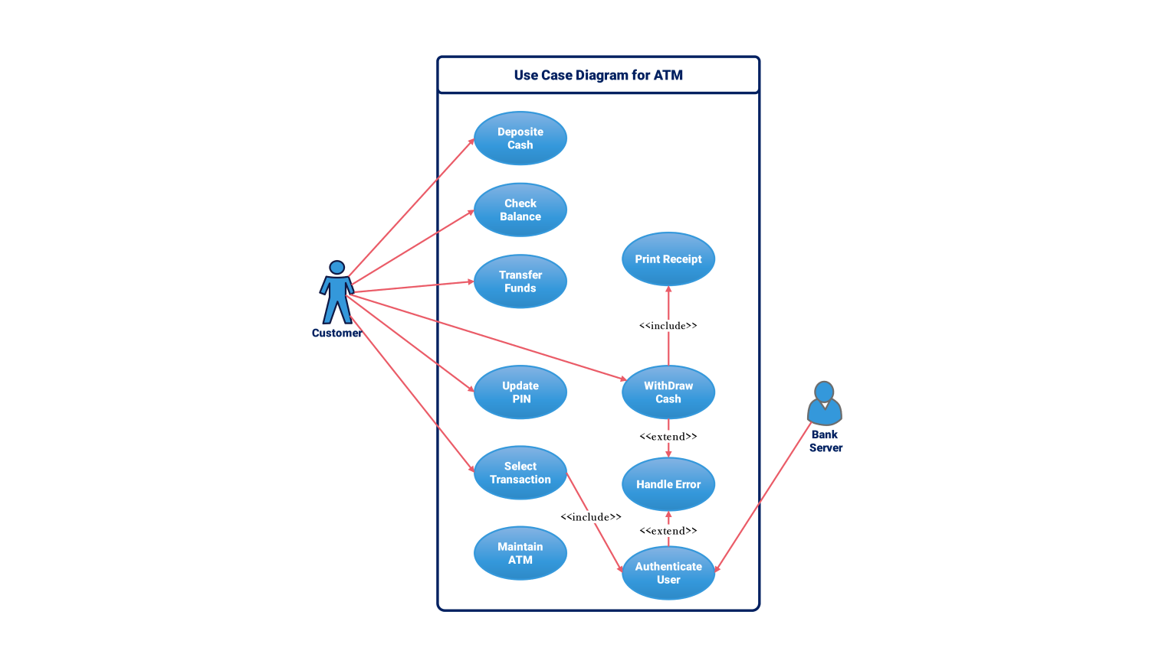

Slide 67
Data Flow Diagrams (DFD)
Represents how data moves through a system.
Components:
Processes (Circle)
Data Stores (Rectangle)
External Entities (Square)
Data Flows (Arrows)

Slide 68
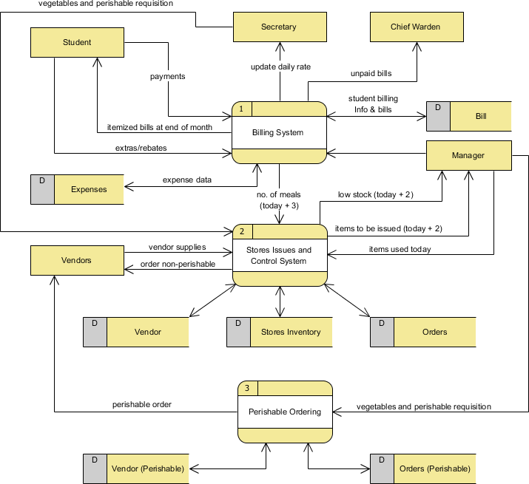

Slide 69
Entity-Relationship Diagram (ERD)
Definition: Diagram that models database structure.
Key Elements:
Entities (Objects like Students, Courses)
Attributes (Properties like Student Name, Course Code)
Relationships (Associations like Enrolled-In)

Slide 70
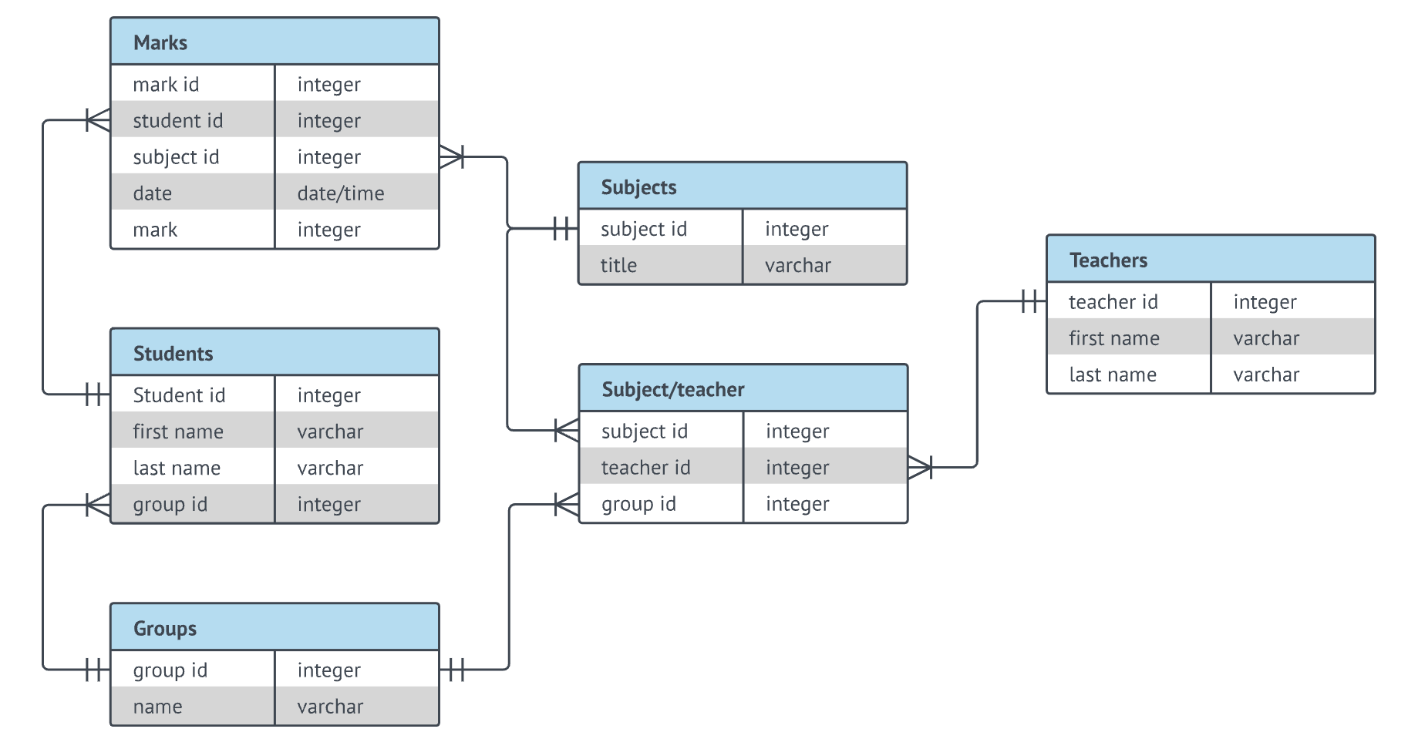

Slide 71
Analysis for Understanding the Domain and Requirements
Domain Analysis:
Identifying system environment, stakeholders, and constraints.
Techniques: Interviews, Questionnaires, Document Analysis.
Requirement Analysis Approaches:
Structured Analysis (DFD, ERD)
Object-Oriented Analysis (UML Diagrams, Class Diagrams)

Slide 72
Use Case Description Format
Use Case Name: Login Process
Actors: User, Authentication System
Preconditions: User must have an account
Main Flow:
User enters username and password.
System verifies credentials.
User is granted access.
Alternative Flow: Wrong password → Show error message.

Slide 73
Formal Specification
Definition: Mathematically-based techniques to specify software requirements.
Why is it useful?
Removes ambiguity.
Improves verification and validation.
Common Methods:
Z-Notation, B-Method, VDM (Vienna Development Method)

Slide 74
Benefits of Using Formal Specification
Precise and unambiguous.
Reduces misinterpretation.
Helps with system validation before development.

Slide 75
Challenges in Requirements Analysis
Common Issues:
Unclear or vague requirements.
Changing requirements.
Conflicting stakeholder interests.
How to overcome them?
Regular communication with stakeholders.
Using prototypes and visual models.

Slide 76
Real-World Example – Software Requirement Failure
Case Study: London Ambulance System Failure
System designed without clear requirements.
Lack of proper analysis led to incorrect dispatching.
Lesson: Proper requirement engineering prevents system failures.

Slide 77
Industry Best Practices in Requirements Engineering
Define SMART Requirements:
Specific, Measurable, Achievable, Relevant, Time-bound.
Use Requirement Management Tools:
JIRA, IBM Rational DOORS, ReqSuite.

Slide 78
Summary
Requirement Analysis ensures clear, complete, and correct requirements.
Modeling Techniques help visualize requirements for better understanding.
Use Case Modeling captures user interactions.
Formal Specification provides a rigorous, mathematical approach to defining requirements.

Slide 79
End of Topic 3

Slide 80
EC3290 – Software Requirements Engineering
Topic 4 – Software Verification and Validation

Slide 81
Learning Objectives
Understand the difference between verification and validation
Explore techniques used in requirement V&V
Learn how to identify conflicts, inconsistencies, and incompleteness in requirements

Slide 82
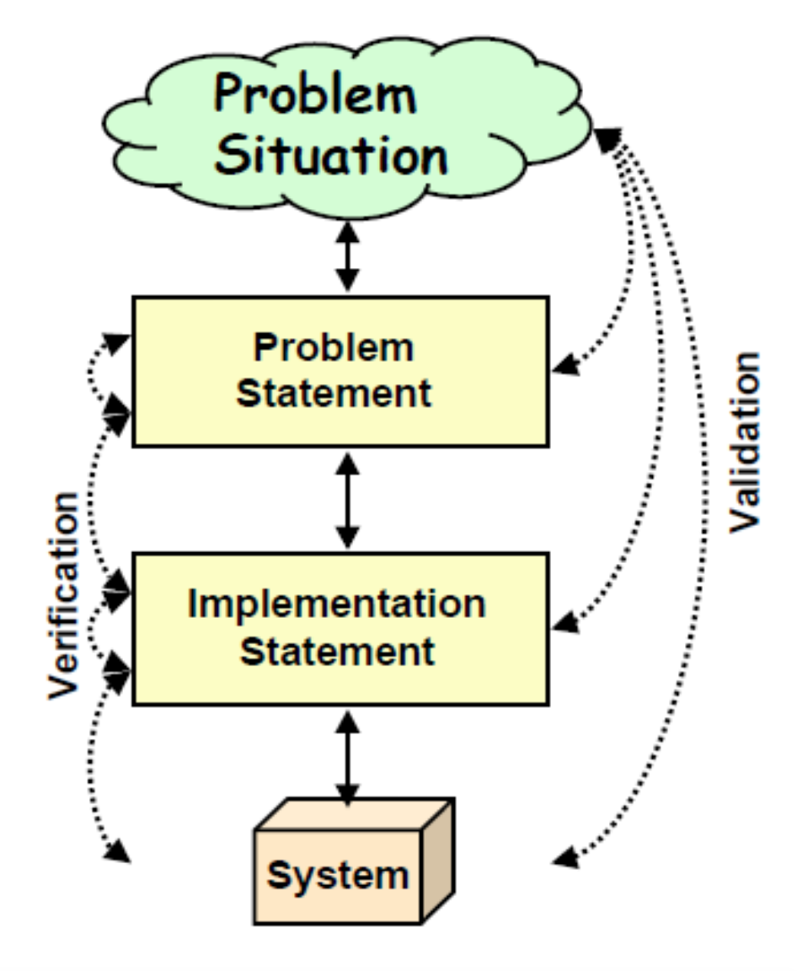
What is Requirements V&V?
Verification
Check if the requirement document is correct and logically structured.
Are we building the product right?
Validation
Confirm if the documented requirements truly reflect the needs of stakeholders.
Are we building the right product?

Slide 83
Importance of V&V
Reduces costly rework in later stages
Ensures customer satisfaction
Improves software quality
Example: NASA lost a $125 million spacecraft because of a requirements error. That's one expensive typo.

Slide 84
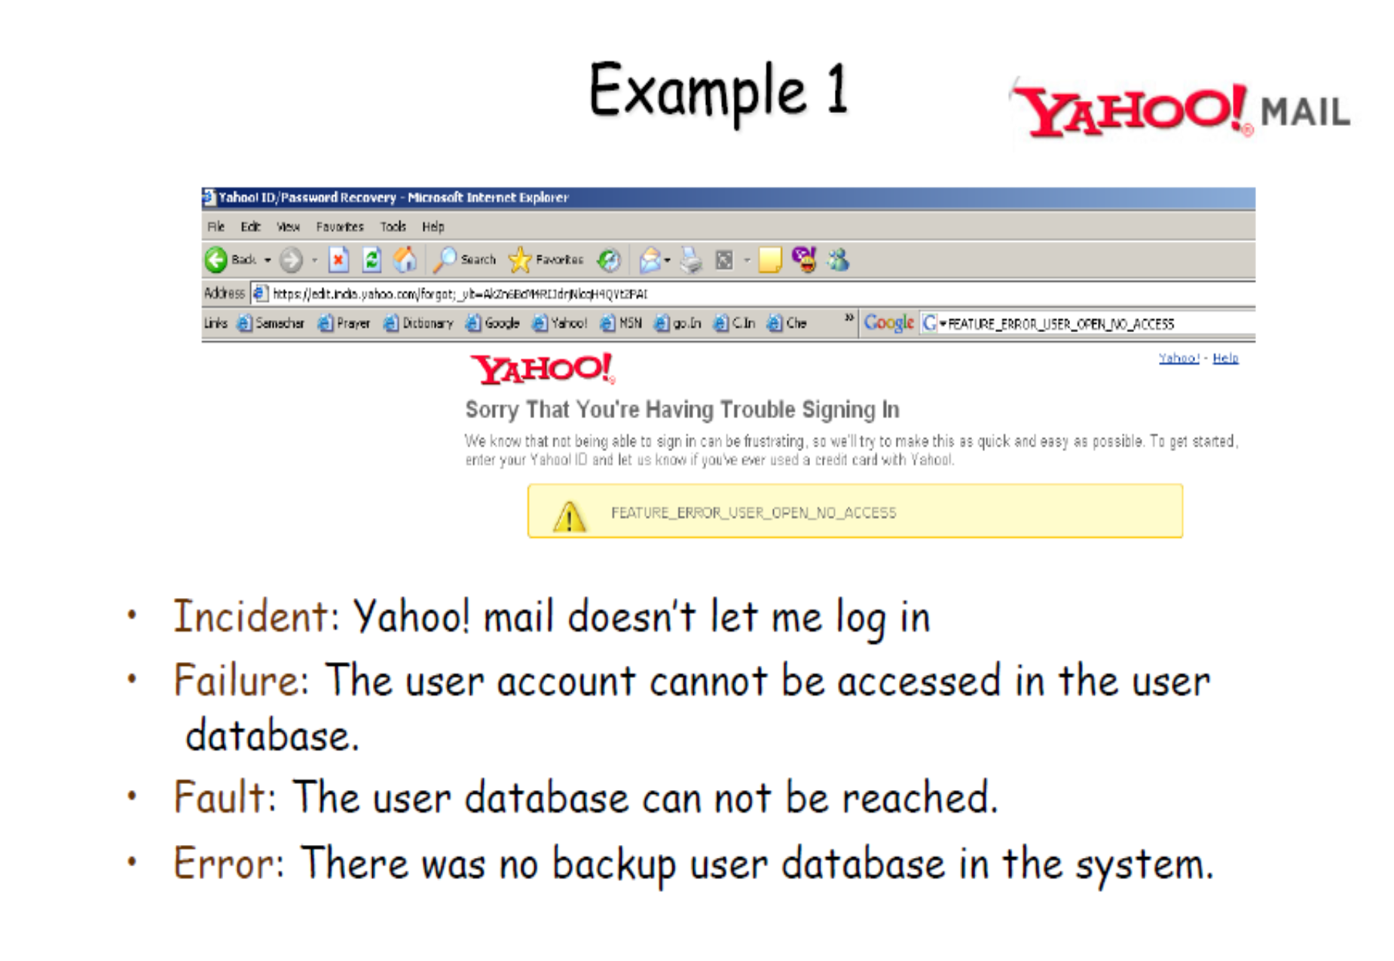

Slide 85
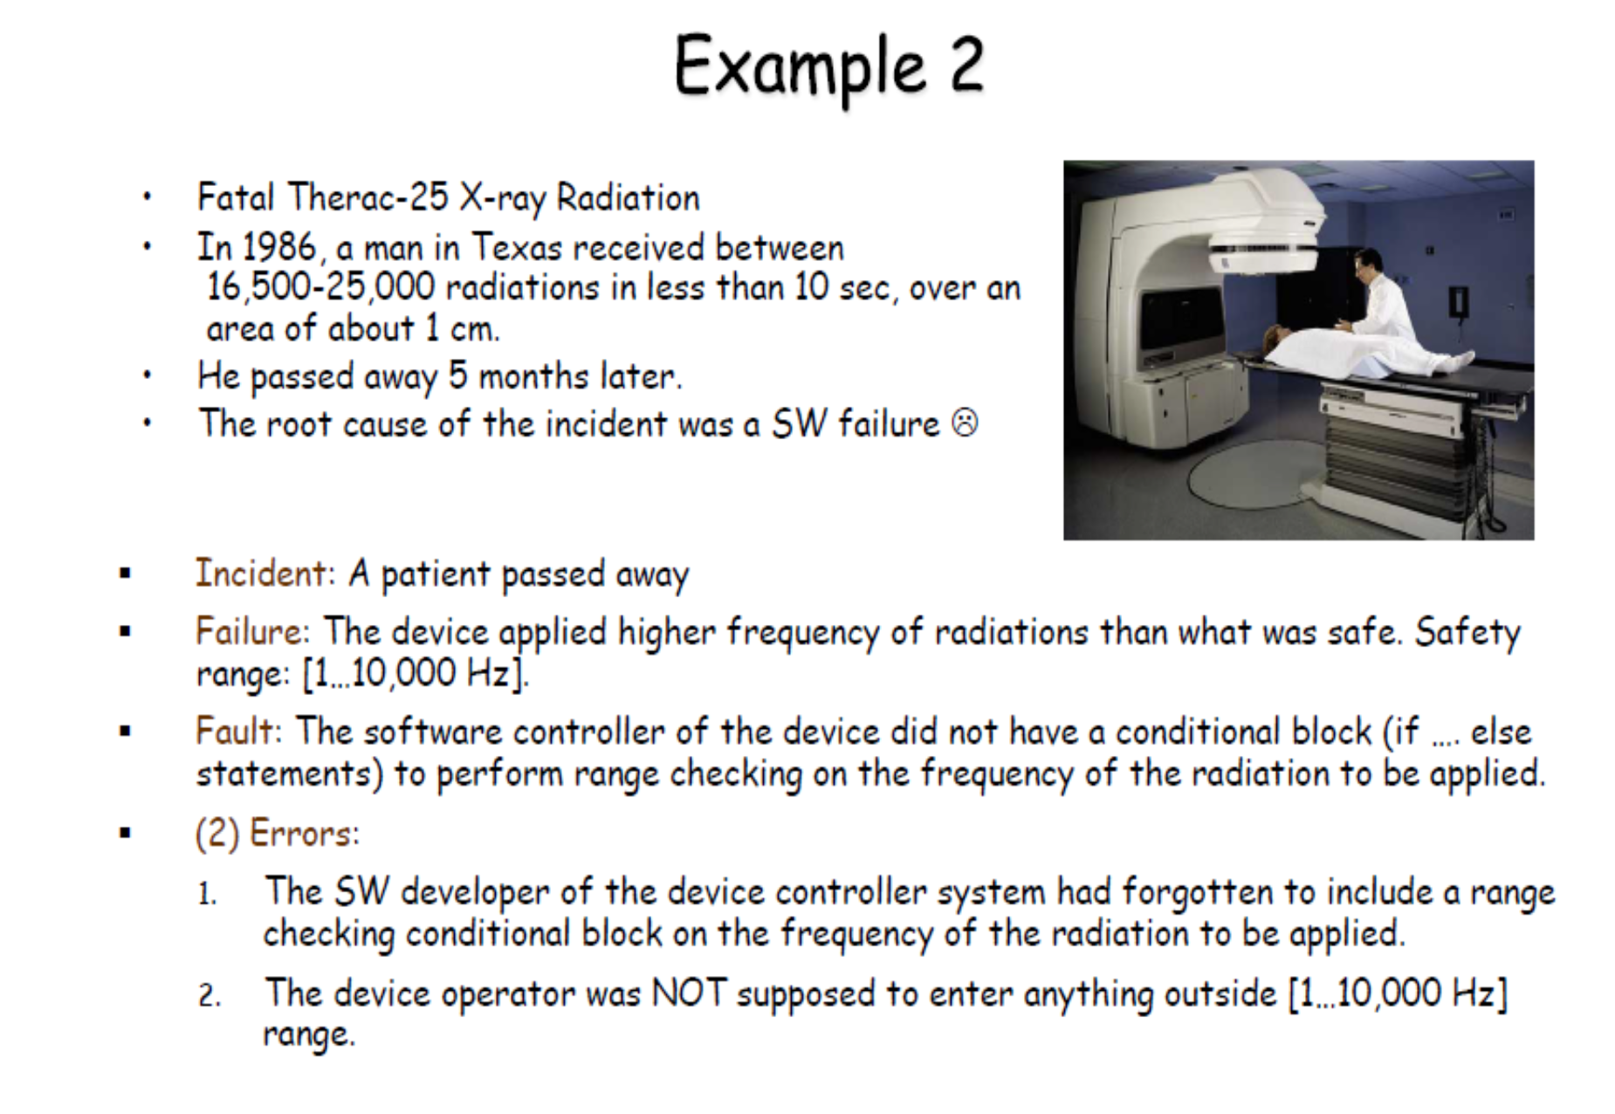

Slide 86
When Does V&V Happen?
Throughout the software development life cycle (SDLC)
Especially during and after requirements elicitation and specification
Before design and implementation begin

Slide 87
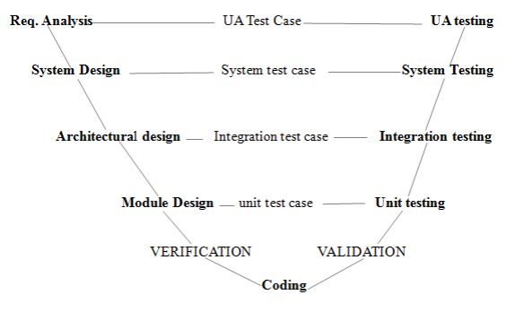

Slide 88
Verification: In-Depth
Ensures the software meets the specified requirements
Focuses on correctness and consistency
Techniques: Reviews, Walkthroughs, Inspections

Slide 89
Validation: In-Depth
Ensures the software fulfills user needs and expectations
Involves stakeholders
Techniques: Prototyping, User Feedback, Acceptance Testing

Slide 90
The V&V Relationship
Verification = Internal check
Validation = External check
Both are essential; one without the other can lead to disaster

Slide 91
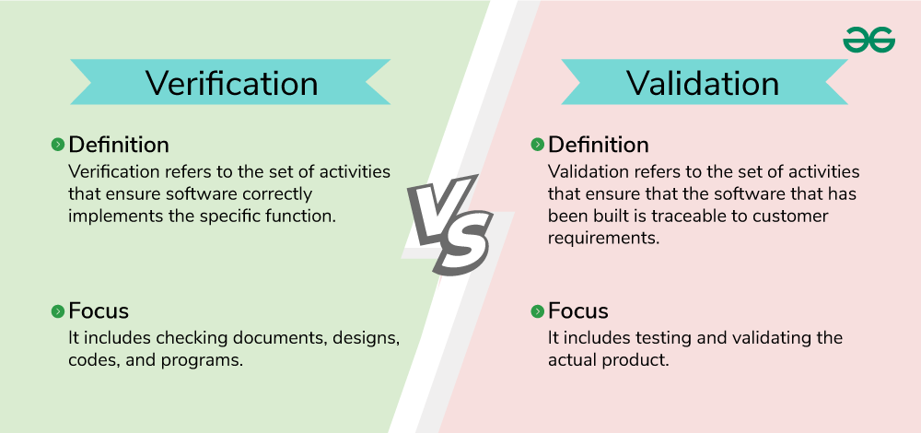

Slide 92
V&V Activities in Requirements Phase
Requirements review
Consistency checks
Prototyping for validation
Traceability analysis

Slide 93
Inspection Techniques
Formal, peer-based examination of documents
Checklist-driven
Focus on:
Ambiguities
Conflicts
Incompleteness

Slide 94
Walkthroughs
Informal group discussion
Presenter leads; others provide feedback
Goal: Understand and evaluate the requirements

Slide 95
Reviews
Technical review meetings
Used to detect errors early
May be formal or informal
Example: Weekly review sessions with client or internal QA team.

Slide 96
Prototyping for Validation
Build a mock-up of the system or interface
Gather feedback from users
Helps discover hidden needs
Because "I’ll know it when I see it" is not a requirement.

Slide 97
Acceptance Criteria and Testing
Define what it means for a requirement to be "done"
Involve end-users in writing test cases
Must be measurable and testable

Slide 98
Conflict Detection in Requirements
Conflict: Two or more requirements contradict each other
Example: One requirement says “System must run in 2 seconds,” another says “Must perform deep analysis.”
Solution: Use traceability and conflict matrices.

Slide 99
Inconsistency Detection
Different parts of the requirement contradict or don’t align
Example: “All users must log in” vs. “Guest users can access without login”
Technique: Cross-checking related requirements.

Slide 100
Completeness Check
Ensures all required functionalities are described
No missing constraints or conditions
Checklist: Are all stakeholders’ needs addressed? Are all interfaces defined?

Slide 101
Ambiguity Detection
Ambiguous: “The system should be fast”
Clear: “System response time shall not exceed 2 seconds under load”

Slide 102
Traceability Matrix
Maps requirements to:
Stakeholder needs
Design components
Test cases Benefit: Helps detect missing or extra functionality Example table: Req1 → Use Case 1 → Module A → Test Case 5

Slide 103
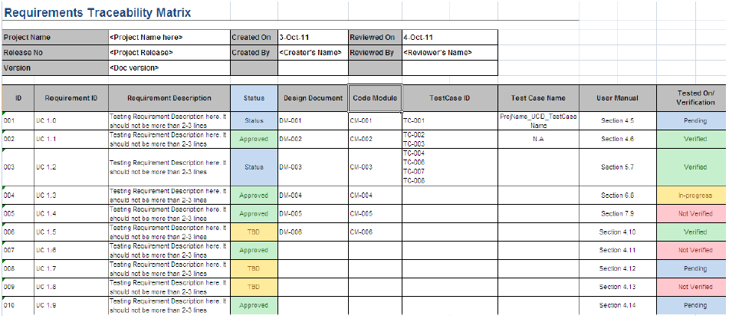

Slide 104
Tool Support for V&V
Tools like:
IBM DOORS
ReqView
JIRA (for issue tracking)
Help automate conflict detection and versioning

Slide 105
V&V in Agile Context
Continuous validation via sprints and reviews
Definition of Done (DoD) ensures verification
User stories and acceptance criteria help validate

Slide 106
Common Mistakes in V&V
Skipping reviews
Relying too much on tools
Not involving users in validation

Slide 107
Summary
V&V ensure correct and complete requirements
Verification = “Did we build it right?”
Validation = “Did we build the right thing?”
Use a variety of techniques: inspection, prototyping, testing

Slide 108
EC3290 – Software Requirements Engineering
Topic 5 – Requirement Evolution and Management

Slide 109
Learning Objectives
This session provides a complete overview of how to manage evolving requirements in software development. You will understand the lifecycle of a requirement and how to manage it effectively as situations change.
Key Points:
Understand the evolving nature of software requirements
Learn to apply requirements traceability techniques
Practice prioritization methods like MoSCoW and Kano
Explore how to manage changes using baselines
Understand the value of reusing requirements

Slide 110
Introduction to Requirements Evolution
Software requirements are not static. They must adapt to changing environments, new stakeholder needs, and unforeseen challenges. Requirements evolution is a natural part of the software lifecycle.
Requirements change due to business and technical drivers
The need for flexibility in planning and documentation
Helps avoid outdated or irrelevant product features

Slide 111
What Causes Requirements to Evolve?
Several internal and external factors influence the need to update software requirements. These changes can have significant impacts on project scope and delivery.
Key Causes:
Stakeholder feedback
Regulatory updates
Competitive market demands
Technical limitations

Slide 112
Real-World Example - Mobile Banking App
A mobile banking app initially supports only local transactions. Later, the client requests international transfer functionality due to business expansion. Requirements evolve to include exchange rates, compliance checks, and international APIs.
Key Points:
Reflects how growth changes user needs
Shows how even small additions can trigger complex changes

Slide 113
Requirements Traceability
Traceability helps track each requirement from origin to deployment. It ensures nothing is missed and every stakeholder need is fulfilled.
Key Points:
Supports impact analysis and auditing
Links requirements to design, code, and tests
Improves accountability and verification

Slide 114
Types of Traceability
Forward Traceability: Requirement → Test
Backward Traceability: Test → Requirement
Bidirectional Traceability: Both directions

Slide 115
Traceability Example - Password Reset
A requirement like "User resets password via OTP" can be traced through design documents, code modules, and test cases.
Trace Links:
Design: OTP input interface
Code: otp_reset.py
Test: TC003
Deploy: Version 1.2

Slide 116
Tools for Traceability
IBM DOORS
Jira with Xray/Zephyr
Jama Connect
ReQtest

Slide 117
Requirements Prioritization
Not all requirements are created equal. Prioritization helps teams focus on delivering the highest value first.
Benefits:
Aligns with business goals
Manages scope effectively
Enhances decision-making in trade-offs

Slide 118
MoSCoW Technique
MoSCoW is a simple but effective prioritization method.
Categories:
Must have: Essential
Should have: Important
Could have: Nice to have
Won’t have: Out of scope (for now)

Slide 119
Kano Model and 100-Dollar Test
Kano Categories:
Basic Needs
Performance Features
Delighters
100-Dollar Test:
Allocate imaginary budget to requirements
Reflects perceived stakeholder value

Slide 120
Value vs. Complexity Matrix
Helps visualize the trade-off between value and implementation difficulty.
Quadrants:
High value, low effort: Prioritize
High value, high effort: Plan with caution
Low value, low effort: Consider
Low value, high effort: Avoid

Slide 121
Example - Mobile Banking App Features
Feature | Priority
Login/Signup | Must
View Balance | Must
Fund Transfer | Should
Budget Planner | Could
Crypto Trading | Won’t

Slide 122
Why Requirements Change
Change is inevitable in software development. Recognizing and managing change is critical.
Reasons:
New insights or feedback
Legal compliance
Feature gaps
New technologies

Slide 123
Change Management Process
Steps:
Submit change request
Analyze impact
Review with stakeholders
Approve or reject
Update baseline and notify team

Slide 124
Requirements Baselines
A baseline freezes the requirements at a given time. All future changes must follow formal procedures.
Benefits:
Provides a reference point
Supports project tracking
Controls scope creep

Slide 125
Configuration Management
Includes:
Version control (e.g., Git)
Change logs
Release notes
Benefits:
Reduces confusion
Tracks evolution over time

Slide 126
Reusing Requirements
Reusability leads to efficiency, especially for common modules.
Examples of Reusable Requirements:
Login authentication
Email notifications
Role-based access
Advantages:
Saves time
Improves reliability

Slide 127
Recap
Requirements are living documents. Managing them means tracking, prioritizing, controlling, and reusing.
Traceability ensures visibility
Prioritization helps decisions
Change must be controlled
Baselines keep projects stable
Reuse builds on past work

Slide 128
EC3290 – Software Requirements Engineering
Topic 5 – Advanced Topics in Software Requirement Engineering

Slide 129
Topics:
Hazard Analysis & Safety-Critical Requirements
Threat Modeling & Security-Critical Requirements
Tool Support in Requirements Engineering
Open Research Challenges

Slide 130
Introduction to Advanced Topics
As modern software systems become increasingly embedded in critical environments—from healthcare and transportation to finance and defense—the field of requirements engineering must evolve. Four advanced areas that reflect the growing demand for dependable, secure, and maintainable systems.

Slide 131
Hazard Analysis and Safety-Critical System Requirements
Safety-critical systems are those where failures can result in catastrophic consequences: human injury, death, or major financial loss. Think of pacemakers, aircraft autopilot systems, or nuclear power controls.
The goal of requirements engineering in such systems is not just to ensure functionality—but to safeguard against harmful scenarios.

Slide 132
Hazard Analysis?
Hazard analysis is the structured process of identifying conditions or events that could lead to system failure or harm. It helps us answer:
What can go wrong?
What are the consequences?
What measures can prevent it?
This early-stage analysis directly influences how safety requirements are written.

Slide 133
Techniques in Hazard Analysis
Three popular techniques are widely used in industry:
FMEA (Failure Modes and Effects Analysis): Assesses how different parts might fail and the impact.
FTA (Fault Tree Analysis): A top-down diagram-based method to analyze cause-and-effect.
HAZOP (Hazard and Operability): A systematic team review to find deviations from intended operations.

Slide 134
Failure Modes and Effects Analysis (FMEA)
FMEA is a bottom-up approach that identifies potential failure modes of each component, analyzes their consequences, and prioritizes them based on severity, occurrence, and detectability.
Steps in FMEA:
List components and functions
Identify how each can fail (failure modes)
Analyze effects of each failure
Assign Risk Priority Number (RPN)
Recommend corrective actions

Slide 135
Failure Modes and Effects Analysis (FMEA)
Example:
In a heart monitor system:
Component: ECG sensor
Failure Mode: Sensor disconnect
Effect: No reading → risk to patient
RPN: High → Add alert system when no signal detected

Slide 136
Fault Tree Analysis (FTA)
FTA is a top-down graphical technique that starts from an undesired event and uses logic gates (AND, OR) to trace the possible root causes.
Steps in FTA:
Define the undesired "top event"
Break down causes using logic gates
Identify minimal cut sets (combinations that can trigger the top event)
Analyze probabilities and dependencies

Slide 137
Fault Tree Analysis (FTA)
Example:
Top event: “Aircraft loses power”
Cause A: Fuel exhaustion
Cause B: Engine control software crash FTA builds a visual tree showing how these causes interact.

Slide 138
Hazard and Operability Study (HAZOP)
HAZOP is a structured team-based technique that analyzes potential deviations from the intended design using guide words like "more," "less," "none," etc.
Steps in HAZOP:
Form a multidisciplinary team
Divide system into nodes/processes
Apply guide words to each node (e.g., "No flow", "More pressure")
Brainstorm possible causes and consequences
Document actions needed

Slide 139
Hazard and Operability Study (HAZOP)
In a chemical plant:
Node: Pipeline transporting gas
Guide word: “More pressure”
Deviation: Pressure above safety threshold
Consequence: Explosion risk
Action: Add pressure relief valve

Slide 140
Comparison of Hazard Analysis Techniques
Technique | Approach | Focus | Best For | Strengths | Limitations
FMEA | Bottom-up | Component-level failures | Mechanical/electrical systems | Simple to apply, quantifies risk | May miss system-level interactions
FTA | Top-down | Undesired events & causes | Aerospace, nuclear, automotive | Clear visualization of failure logic | Complex for large systems
HAZOP | Team-based with guide words | Process deviations | Chemical/process industries | Encourages brainstorming, very thorough | Time-consuming, needs expertise

Slide 141
From Hazards to Requirements
Once hazards are known, we specify how the system should respond or prevent these situations. For example:
Hazard: Sensor overheating
Requirement: “The system shall shut down the module if temperature exceeds 80°C.”
These are non-functional requirements, often focusing on system behavior under stress or failure.

Slide 142
Threat Modeling and Security-Critical Requirements
Why Security Matters
Security is now an essential requirement in almost every system. From personal apps to critical infrastructure, breaches can expose private data or even endanger lives.
Unlike hazards (accidental), threats are intentional, posed by attackers. Our role is to anticipate and mitigate them through proper requirements.

Slide 143
Threat Modeling
Threat modeling is a proactive approach to uncovering and analyzing security threats during the design phase.
Steps include:
Identifying assets (data, user credentials, etc.)
Listing potential attackers and their motives
Pinpointing vulnerabilities
Defining countermeasures

Slide 144
STRIDE Framework
The STRIDE model categorizes six types of threats:
Spoofing: Impersonating identities
Tampering: Modifying data
Repudiation: Denying actions
Information Disclosure: Leaking data
Denial of Service: Disrupting services
Elevation of Privilege: Gaining unauthorized access
For each threat type, we derive one or more security requirements.

Slide 145
S – Spoofing Identity
What is Spoofing? When someone pretends to be someone else to gain unauthorized access.
Example:
A hacker logs into a system using someone else’s username and password.
Analogy:
Like someone using a fake ID to enter a restricted event pretending to be someone else.
Real-world Scenario:
An attacker uses a phishing website that looks like a real bank site to trick users into logging in, then steals their credentials.
Typical Requirement to Prevent:
“The system shall enforce multi-factor authentication for all user logins.”

Slide 146
T – Tampering with Data
What is Tampering? When someone changes data without permission.
Example:
Modifying a software file to insert malicious code.
Changing the amount in a bank transfer during transmission.
Analogy:
Like altering a signed document to change the contract terms.
Real-world Scenario:
Hackers inject malicious scripts into a website (e.g., form hijacking in e-commerce sites).
Typical Requirement to Prevent:
“All transmitted data shall be encrypted and validated upon receipt.”

Slide 147
R – Repudiation
What is Repudiation? When a user denies having performed an action, and there’s no proof to say otherwise.
Example:
A user deletes records and claims they didn’t do it.
Analogy:
Imagine someone claiming, “I didn’t send that email,” and you can’t prove otherwise.
Real-world Scenario:
A system with no logging mechanism allows users to delete files without tracking who did it.
Typical Requirement to Prevent:
“The system shall maintain detailed and tamper-proof logs of all user actions.”

Slide 148
I – Information Disclosure
What is Information Disclosure? When sensitive information is exposed to someone who shouldn’t have access to it.
Example:
A website mistakenly shows other users’ account info.
Analogy:
Like a bank teller shouting out your account balance in public.
Real-world Scenario:
A developer forgets to turn off debug mode, and sensitive data is shown in browser error messages.
Typical Requirement to Prevent:
“The system shall ensure access controls are applied to all confidential data.”

Slide 149
D – Denial of Service (DoS)
What is Denial of Service? When someone makes a system unavailable to others by overwhelming it.
Example:
A flood of traffic crashes a website so real users can’t access it.
Analogy:
Like filling up all the seats in a theater with fake bookings so real people can’t attend.
Real-world Scenario:
Bot attacks on an online store during a sale to block other buyers.
Typical Requirement to Prevent:
“The system shall detect and limit excessive requests from a single source.”

Slide 150
E – Elevation of Privilege
What is Elevation of Privilege? When someone gains more access or power than they’re supposed to have.
Example:
A regular user finds a flaw and becomes an admin.
Analogy:
Imagine a junior staff member finding the keys to the CEO's office and taking over.
Real-world Scenario:
Exploiting a bug to bypass role checks and access restricted parts of the system.
Typical Requirement to Prevent:
“The system shall enforce role-based access control for all operations.”

Slide 151
STRIDE Summary Table
Threat | Description | Example | Requirement
Spoofing | Pretending to be someone else | Fake login credentials | Use two-factor authentication
Tampering | Changing data or files | Modify code during update | Use encryption and validation
Repudiation | Denying actions without proof | Delete logs, deny wrongdoing | Use audit logs
Info Disclosure | Exposing sensitive info | Leak user data in error | Apply access control
DoS | Overloading systems | Attack to crash website | Use rate-limiting
EoP | Gaining extra access | Regular user becomes admin | Role-based access control

Slide 152
Security-Critical Requirements Example
Imagine a mobile banking app:
Threat: Credential theft
Requirement: “The system shall enforce biometric login for all high-value transactions.”
Good security requirements must be clear, testable, and directly address identified threats.

Slide 153
Tool Support for Requirements Engineering
As systems and requirements grow in number and complexity, manual tracking becomes inefficient and risky. Tools offer support for:
Requirement gathering
Traceability
Change management
Consistency checking

Slide 154
Categories of Requirements Tools
Requirements Management Tools: e.g., IBM DOORS, Jama Connect
Modeling Tools: e.g., Enterprise Architect
Traceability Tools: e.g., Reqtify
Formal Verification Tools: e.g., Alloy, SPIN
Each tool specializes in a phase of the requirements lifecycle—from elicitation to validation.

Slide 155
Key Benefits of Tools
Using tools can help:
Ensure requirements traceability (from user needs to code)
Avoid duplication or conflicts
Manage requirements evolution over time
Facilitate team collaboration
Enable regulatory compliance in safety/security-critical projects

Slide 156
Example Tool Workflow
A typical workflow could look like this:
Define requirements in IBM DOORS
Model interactions in Enterprise Architect
Link tests in JIRA
Maintain traceability with Reqtify This ensures consistency and confidence that all requirements are being fulfilled.

Slide 157
Open Research Problems in Requirements Engineering
Today’s systems are adaptive, intelligent, and operate in real-time environments. Static requirements documents cannot capture their fluid behavior.
This evolution opens up several research problems that scholars and engineers are actively working on.

Slide 158
Major Open Research Problems
Dynamic Requirements in Agile How to trace and validate rapidly evolving requirements?
Ambiguity in Natural Language Can we auto-detect vague terms like “fast,” “secure,” or “user-friendly”?
AI and Learning Systems How do we define “correct behavior” in systems that evolve?
Ethics and Responsibility How do we encode social values (e.g., fairness, explainability)?
Automation in Requirements Elicitation Can AI help extract requirements from user stories, emails, or transcripts?

Slide 159
Future Directions and Innovations
NLP for automated requirement classification
Ontologies for domain-specific vocabularies
Crowdsourcing to collect public requirements
Digital Twins to simulate and validate requirements in real-time

Slide 160
Summary
We’ve explored:
How hazard analysis supports safety in critical systems
How threat modeling anticipates malicious attacks
How tools make requirement management scalable
The future of requirements engineering in AI, ethics, and automation
As software continues to shape our world, the way we define, manage, and validate requirements must evolve too.

